Slide 1
Monterey Bay Community Power and Silicon Valley Clean Energy Joint RFP for Renewable Portfolio Standard Resources to Achieve Carbon-Free Goals Bidders Webinar May 5, 2019 1:00 to 2:00 pm - PPT

Slide 2
Overview
Objectives
Process & Schedule
Products Being Sought
Evaluation, Scoring and Ranking
Submission Process
Shortlisted Proposals
Questions and Answers

Slide 3
Objectives
Achieve Carbon-Free Electric Supply Portfolios
Met with large hydro and RPS eligible resources
Measured on an annual basis
Procure sufficient RPS Resources in Compliance Period 4 to meet PCC1 and long-term needs
Up to 800,000 MWh per year combined – 10% of each CCA’s annual needs
Minimum of ten years
COD as early as 2021 but no later than December 31, 2022
Manage energy supply cost exposure
Enhance Grid Reliability
Facilitate decarbonization, electrification and customer-specific sustainability goals

Slide 4
Joint RFP Process
RFP Issued / Question & Answer Period:
Participants may submit questions concerning the RFP at EnergyRFP@SVCleanEnergy.org and may continue to do so until May 10, 2019. Answers to questions will be posted to SVCE’s and MBCP’s RFO webpages.
Offers Due: Proposer’s Offer(s) must be submitted by the May 17, 2019 5:00 PM PPT deadline and include the required documents described herein.
Phase 1 – Review, Score and Rank Offers: SVCE, MBCP and Ascend Analytics will score and rank all compliant Offers based on the Scoring Rubric.
Phase 2 – Top-scoring Offers will be modeled within SVCE and MBCP portfolios to assess fit and value. Best fit and highest value Offers will be Shortlisted and Proposers will be notified of status.
Negotiations and Execution: SVCE & MBCP will negotiate PPAs with Shortlisted participants with the intention of executing PPA(s). SVCE & MBCP may execute PPAs with selected participants at any time during the negotiation phase or may choose to execute none at all.
Final Execution of PPA(s) is contingent on gaining approval from the respective Board of Directors for SVCE and MBCP
Offers may be Shortlisted by either SVCE or MBCP, depending on offered contract quantity. If the contract quantity from a single offer exceeds the needs of either SVCE or MBCP individually, SVCE and MBCP may select this offer together for Shortlisting, with subsequent joint negotiations to produce two separate, but substantially similar, PPAs that Seller would execute with each entity.

Slide 5
Joint RFP Schedule
Activity | Scheduled Date
Issuance of RFP | April 17, 2019
Bidder Webinar | May 3, 2019 at 1:00 PM PPT
Deadline to submit questions | May 7, 2019 at 5:00 PM PPT
Responses to questions provided | May 10, 2019 at 5:00 PM PPT
Deadline to submit proposals | May 17, 2019 at 5:00 PM PPT
Proposal Clarification Contact Period | May 20 – 29, 2019
Notification of final shortlisted Bidders (Tentative) | June 14, 2019
PPA negotiations | July-December 2019
Final contract approval | December 2019

Slide 6
Product Requirements
NOTE: Red text = Required component
Eligible Resources | RPS Eligible PCC1
Project Attributes | Capacity, Energy, Environmental Attributes/Renewable Energy Credits (RECs), and Ancillary Services associated.
Project Location | The project must be “in-state” or have a first point of interconnection within a California Balancing Authority (e.g., CAISO, LADWP, BANC, IID, TID).
Delivery Term | In an effort to meet California’s RPS requirements for Compliance Period 4 (2021-2024), MBCP & SVCE prefer resources with a commercial on-line date (COD) of January 1, 2021 but no later than December 31, 2022. Minimum term of ten years. (Term lengths of 15 and 20 years will also be considered.)
Scheduling and Dispatch Flexibility | MBCP & SVCE prefer to provide Schedule Coordinator (SC) services
Price & Settlement - strongly preferred | Fixed Price ($/MWh) - No escalator Priced at the Project Pnode (i.e., the CAISO pricing node assigned to the generator) and at least one of the following Trading Hubs: PG&E DLAP NP15
Energy Storage Option | Highly encouraged for Solar resources. Price submitted as $/kW-mo.
Minimum Capacity | Proposed Projects must meet one of the following minimum sizes: 20 MW for variable (un-firmed) solar and wind projects 5 MW for non-variable resources (firmed solar/wind, geothermal, storage, small hydro, etc) 50,000 MWh/year for energy and RECs only offers

Slide 7
Phase 1: Evaluation of Offers – Scoring Rubric
Criteria Component | Points
Cost | 35
Project Risk | 15
On-Peak Delivery | 10
Bidder Experience delivering projects of similar scope and magnitude | 10
Location | 10
Resource Adequacy | 10
Clarity and thoroughness of proposal | 5
Bonus for COD by December 2021 | 5
Total: | 100
Cost - Based on the competitiveness of their total cost relative to other projects of a similar type.
Project Risk - Qualitative assessment of the risks inherent in the proposed project.
On-peak Delivery – Valuation of ability to provide clean energy during this valuable time period.
Other components are self-explanatory

Slide 8
Submittal Documents
1. Completed Offer Form – Appendix A (spreadsheet)
2. Proforma Term Sheet – Appendix B (redline Word document)
3. Executive Summary – 2 pages maximum (PDF) [Refer to section 6.2.2 and Scoring Rubric]
Compliant Proposals are those meeting Submittal and Product requirements.

Slide 9
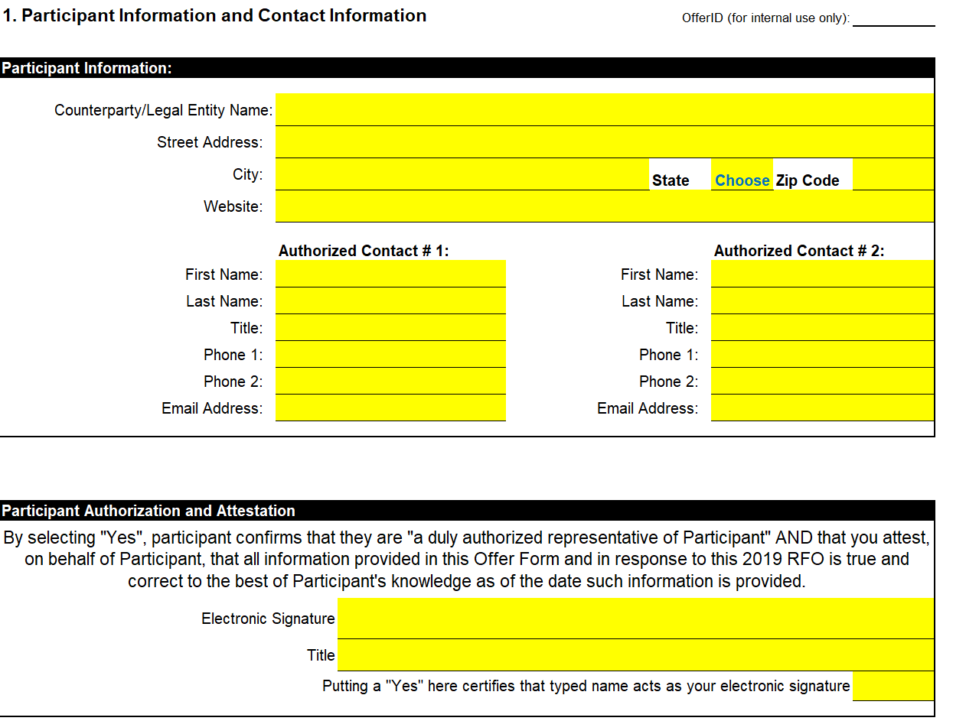
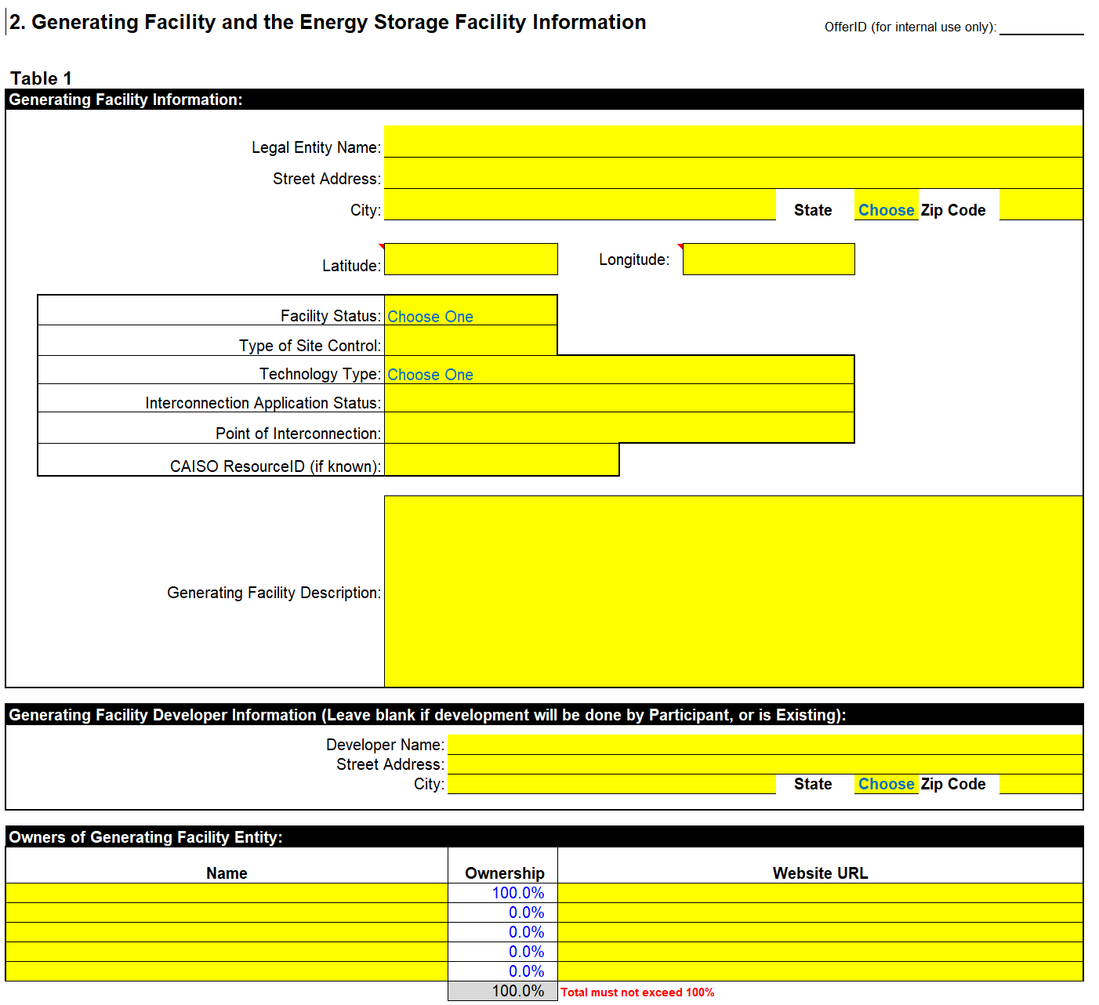
Offer Form – Appendix A

Slide 10
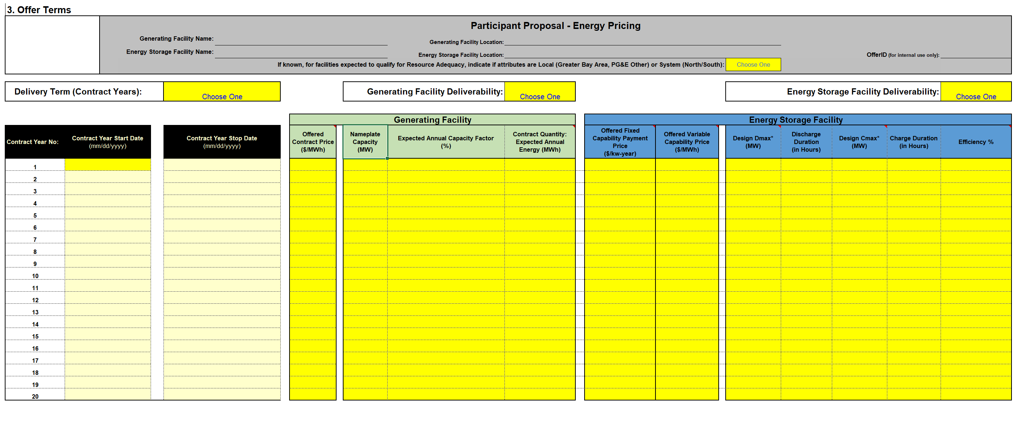
Offer Form – Appendix A
For any questions about completing the Offer Forms, please directly contact: EnergyRFP@SVCleanEnergy.org

Slide 11
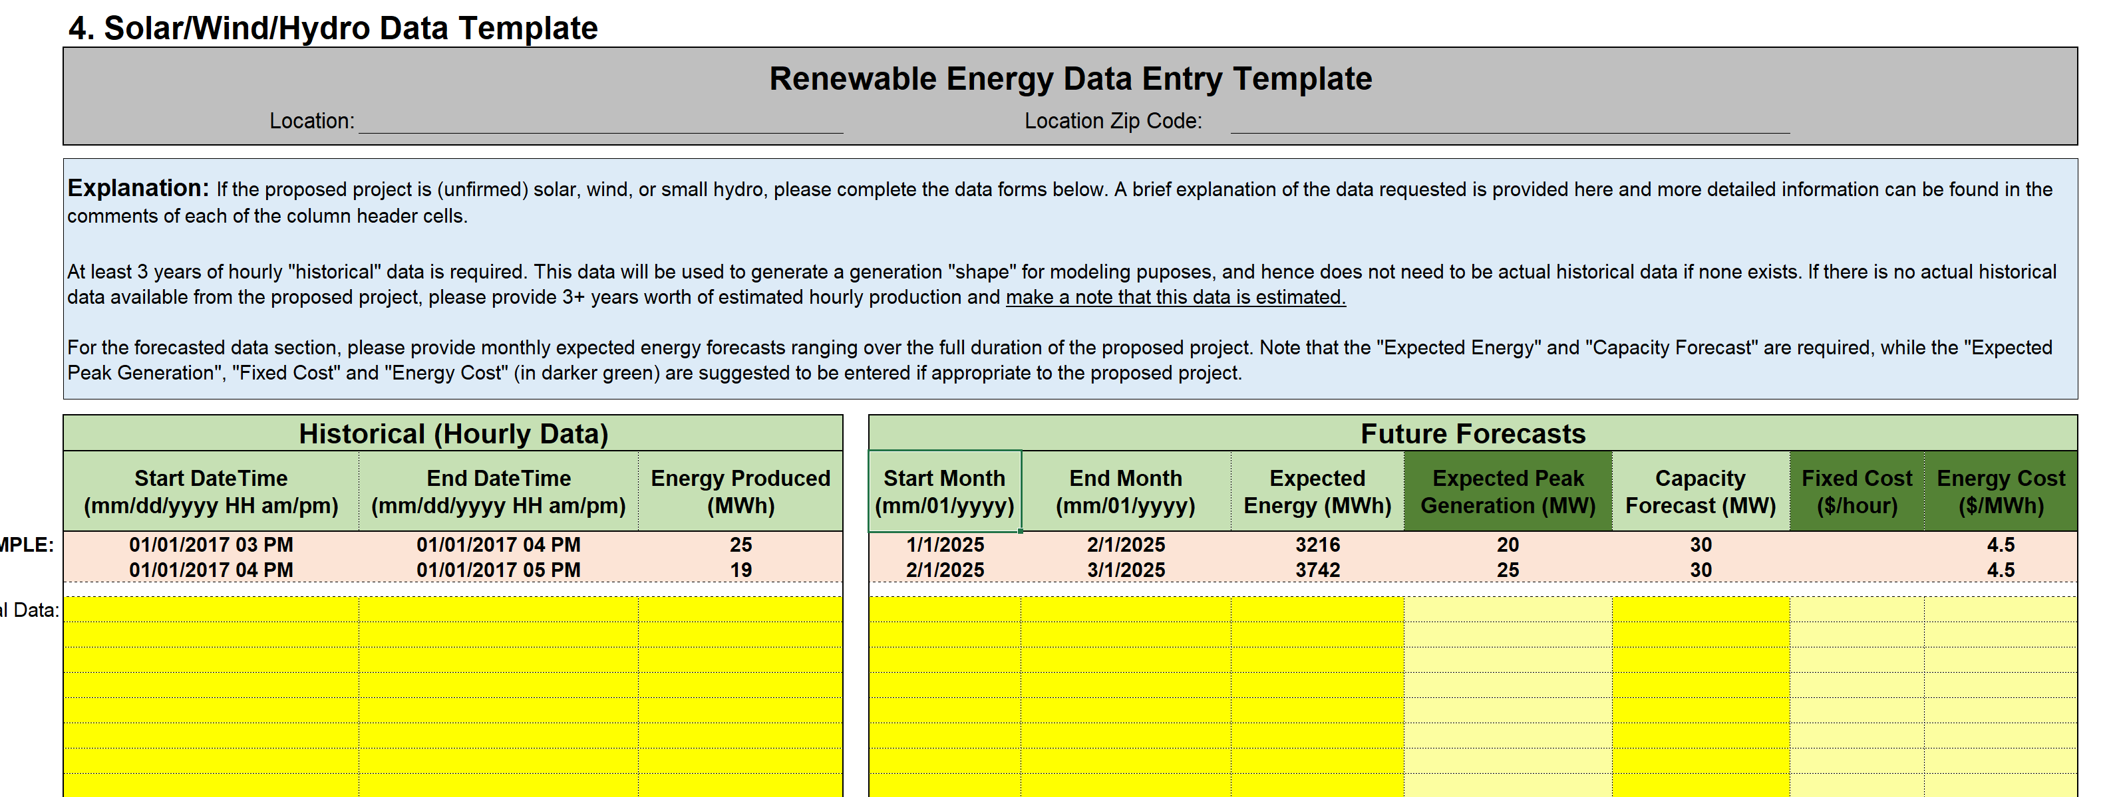
Offer Form – Appendix A
For any questions about completing the Offer Forms, please directly contact: EnergyRFP@SVCleanEnergy.org

Slide 12
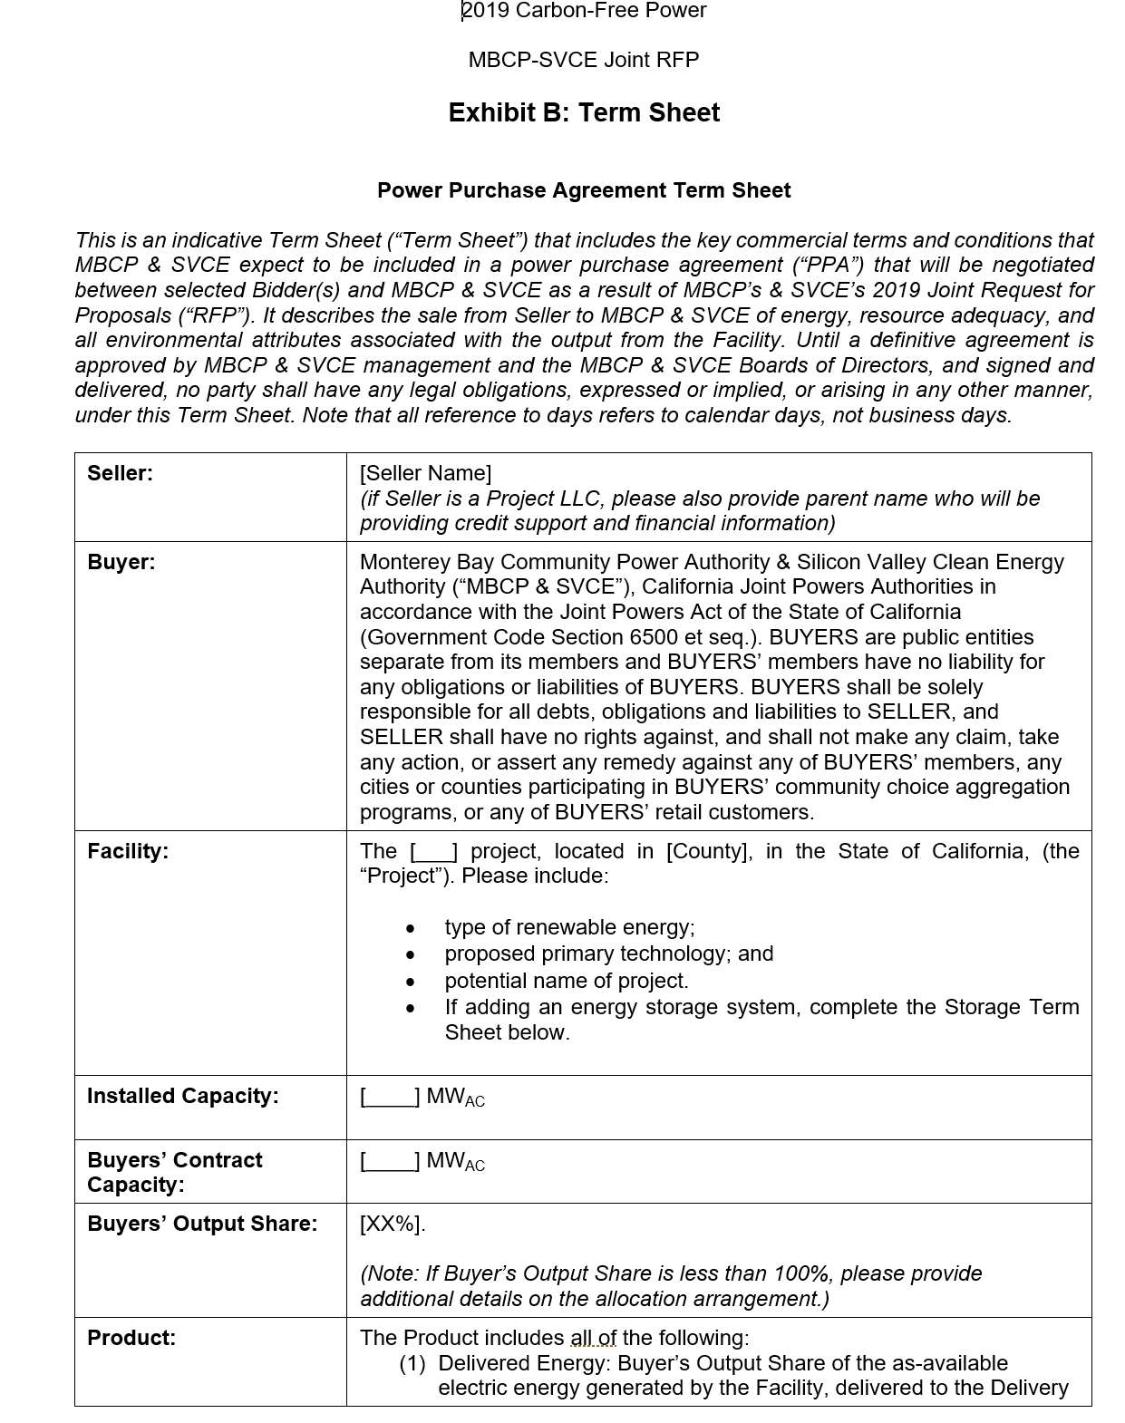
Proforma Term Sheet – Appendix B
Provide a red-line of the Proforma Term Sheet with project specific attributes, terms and conditions. The Proforma Term Sheet is indicative only.

Slide 13
Executive Summary
For the purpose of scoring and ranking, proposals must include a summary of the following:
Cost – Proposed PPA rate ($/MWh) and term
Project Risk - Likelihood of project delaying/failing to come on-line, potential risks to delivery, etc
On-peak Delivery – Ability to deliver energy in expensive hours
Experience – Organization’s creditworthiness and development experience
Project Location – Resource location and proximity to load
Reliability and Resource Adequacy – Ability to meet RA requirements
Two Pages Maximum in PDF format

Slide 14
Clarifications
Submittal Due Date
Note that there was an error in the original RFO release stating an incorrect Submittal Due Date. The final submission due date is May 17th, 2019 at 5pm.
Preferred Delivery Shape
Ideal delivery shape would match Hourly Load Shapes, as linked in the RFO document.
Anticipating an increase in evening ramp (neck of the duck curve), energy delivery during evening peak hours of approximately 4-7pm is highly desired.

Slide 15
Submittal Documents
1. Completed Offer Form – Appendix A (spreadsheet)
2. Proforma Term Sheet – Appendix B (redline Word document)
3. Executive Summary – 2 pages maximum (PDF) [Refer to section 6.2.2 and Scoring Rubric]
Compliant Proposals are those meeting Submittal and Product requirements.

Slide 16
Shortlisted Offers & Required Documents
The following items are due within 7 business days of notification that your Offer has been Shortlisted* to move to the Negotiation phase of this Joint RFO:
1) Receipt by SVCE or MBCP of the required Offer Deposit
2) An executed Confidentiality Agreement
3) A completed Credit and Finance Information Form
A preferred form of Power Purchase Agreement will be sent only to Shortlisted Offers.
* If more time is needed after Shortlisting notification, vendors may request an extension before the 7 day window has expired. MBCP and SVCE will notify vendors if the extension is granted.

Slide 17
Required Credit/Security Deposits from Shortlisted Offers
Offer Deposit of $3/kW upon Shortlisting
Following PPA execution, a Project Development Security of:
$60/kW for generation resources
$90/kW for storage resources
Upon Commercial Operation:
Delivery Term Security - To be determined by Buyers, but likely to be as follows:
Payment Types:
Offer Deposit and Project Development Security – cash or Letter of Credit
Delivery Term Security – cash, Letter of Credit, or acceptable guarantee
Term | 10 years | 15 years | 20 years
Months Revenue | 6 | 9 | 12

Slide 18
Submitting Offers
Offers must include all Submittal documents in the format requested
Offers must be received on or before May 17, 2019 5:00pm PPT.
Participants may submit multiple offers, limited to 8 unique offers*
Only electronic copies will be accepted and must be submitted to mailbox: EnergyRFP@SVCleanEnergy.org
Note: this is the only email address to use for submission of offers. You do NOT need to submit the same offer to SVCE and then to MBCP. Both parties will receive the offers.
*This slide has been update from the May 3, 2019 Bidders Webinar to reflect that there is no limit to the number of offers per Bidder.

Slide 19
Questions and Answers

Slide 20
Communications and Website
All RFO documents are available on each CCA’s website at:
SVCE: https://www.svcleanenergy.org/solicitations/
MBCP: https://www.mbcommunitypower.org/current_requests_for/2019-carbon-free-power-supply-joint-request-for-proposals/
All announcements, updates and Q&As will also be posted on the websites.
All communications should be directed to:
EnergyRFP@SVCleanEnergy.org

